Slide 1

CS361: Computer Architecture
Instruction-level Parallelism
An Example Pipelining Task
Space-Time Diagram
CS324 Computer Architecture 1

Slide 2




PIPELINING INSTRUCTIONS
Overlapping of instructions is made possible by associating a register with each segment in the pipeline
– Each segment consists of an input register (to hold data) followed by a combinatorial circuit (that performs the required sub-operation)
Example Structure of a 4-Segment Pipeline
Clock
S₁
R₁
S₂
R₂
S₃
R₃
S₄
R₄
Input
The registers provide isolation between each segment so that each can operate on distinct data simultaneously
The output (intermediate result) from one segment is applied to the
input register of the next segment
A clock is applied to all registers to ensure information flow through the pipeline one step at a time

Slide 3
WHAT TASKS CAN BENEFIT FROM PIPELINING?
1. Any task that can be decomposed into a sequence of sub- operations of about the same complexity can be implemented by a pipelined processor
– Task in the context of pipelining can thus be defined as the total
operation performed going through all the segments of the pipeline
2. Tasks that need to repeat the same operation many times with different set of data may also benefit from pipelining

Slide 4
EXAMPLE: A PIPELINING TASK
Loop: A_{i} * B_{i} + C_{i} for i = 1, 2, 3, ... , 7
One stage of the task listed in form of Microoperations
R1 ← A_{i}, R2 ← B_{i} Load A_{i} and B_{i}
R3 ← R1 * R2, R4 ← C_{i} Multiply and load C_{i} R5 ← R3 + R4 Add
Memory
B_{i}
A_{i}
C_{i}
Segment 1
R1
R2
Multiplier unit
Segment 2
R3
R4
Adder unit
Segment 3
R5

Slide 5
EXAMPLE: A PIPELINING TASK
Memory
B_{i}
A_{i}
C_{i}
R1 ← A_{i}, R2 ← B_{i}
Segment 1
R1
R2
R3 ← R1 * R2, R4 ← C_{i} R5 ← R3 + R4
Multiplier unit
Segment 2
R3
R4
Segment 3
Adder unit
Operations in each pipeline stage
Segment 1 Segment 2 Segment 3
Clock
R5
Pulse
Number | R1 | R2 | R3 | R4 | R5
1 | A1 | B1
2 | A2 | B2 | A1 * B1 | C1
3 | A3 | B3 | A2 * B2 | C2 | A1 * B1 + C1
4 | A4 | B4 | A3 * B3 | C3 | A2 * B2 + C2
5 | A5 | B5 | A4 * B4 | C4 | A3 * B3 + C3
6 | A6 | B6 | A5 * B5 | C5 | A4 * B4 + C4
7 | A7 | B7 | A6 * B6 | C6 | A5 * B5 + C5
8 |  |  | A7 * B7 | C7 | A6 * B6 + C6
9 |  |  |  |  | A7 * B7 + C7

Slide 6
SPACE-TIME DIAGRAM
Space-time diagram illustrates the behaviour of a pipeline by showing segment utilization as a function of time
Space-Time Diagram of a 4-segment pipeline
Clock cycles
1
1 I1 | 2 I2 | 3 I3 | 4 I4 | 5 I5 | 6 I6 | 7 | 8 | 9
 | I1 | I2 | I3 | I4 | I5 | I6
 |  | I1 | I2 | I3 | I4 | I5 | I6
 |  |  | I1 | I2 | I3 | I4 | I5 | I6
2
3
4
Segment
Time in clock cycles on horizontal axis
Segment number on vertical axis
Six instructions, I1 through I6 are executed in 4 segments
I1 completes its execution after the 4th clock cycle. From then on, the pipe
completes a task every clock cycle
» Pipelining “rule of thumb”: No matter how many segments there are in a pipe, once the pipeline is full, it takes only one clock cycle to obtain an output.

Slide 7
CS361: Computer Architecture
Instruction-level Parallelism
Pipeline Speedup
Pipelining: Theoretical Speedup
CS324 Computer Architecture 1

Slide 8
EXAMPLE: A PIPELINING TASK
Loop: A_{i} * B_{i} + C_{i} for i = 1, 2, 3, ... , 7
Microoperations required to complete one instruction
R1 ← A_{i}, R2 ← B_{i} Load A_{i} and B_{i}
R3 ← R1 * R2, R4 ← C_{i} Multiply and load C_{i} R5 ← R3 + R4 Add
Memory
B_{i}
A_{i}
C_{i}
Segment 1
R1
R2
Multiplier unit
Segment 2
R3
R4
Adder unit
Segment 3
R5

Slide 9



SPEEDUP SCENARIO-I
Un-pipelined execution
R1 ← Ai,
R2 ← Bi
R3 ← R1 * R2,
R4 ← Ci
R5 ← R3 + R4
CPI = 3
Un-pipelined execution of the loop takes 7 x 3 clock cycles to complete
– Assuming the clock cycle time of 1ns, then according to the CPU time equation:
CPU time = number of instructions x CPI x clock cycle time
= 7 x 3 x 1ns
CPU time = n x tn
= 21ns

Slide 10
SPEEDUP SCENARIO-I
Pipelined execution
Clock Pulse Number | Segment 1 |  | Segment 2 |  | Segment 3
 | R1 | R2 | R3 | R4 | R5
1 | A1 | B1
2 | A2 | B2 | A1 * B1 | C1
3 | A3 | B3 | A2 * B2 | C2 | A1 * B1 + C1
4 | A4 | B4 | A3 * B3 | C3 | A2 * B2 + C2
5 | A5 | B5 | A4 * B4 | C4 | A3 * B3 + C3
6 | A6 | B6 | A5 * B5 | C5 | A4 * B4 + C4
7 | A7 | B7 | A6 * B6 | C6 | A5 * B5 + C5
8 |  |  | A7 * B7 | C7 | A6 * B6 + C6
9 |  |  |  |  | A7 * B7 + C7
Pipelined execution takes only 9 clock cycles to complete as shown in the table above (or 9ns assuming clock cycle time = 1 ns)
Speedup = Time_{un-pipelined}/Time_{pipelined} = 21ns / 9ns = 2.33
Let's now generalize the Speedup equation

Slide 11
GENERALIZED SPEEDUP EQUATION
n: Number of instructions to be executed
(n = 7 in the previous slide scenario-I)
Conventional Machine (un-pipelined case) t_{n}: Time to complete each instruction
(t_{n} = CPI x clock cycle time = 3 x 1ns = 3ns in scenario-I)
Then n instructions will be completed in Time_{unpipe} = n * t_{n}
^{(Time}unpipe
= 7 x 3ns = 21ns in scenario-I)
Pipelined Machine (with k segments) (k=3 in scenario-I)
t_{p}: Time to complete each segment (1ns in scenario-I)
The first instruction requires a time equal to k.t_{p} to complete its execution (3ns in scenario-I)
The remaining (n – 1) instructions emerge from the pipe at the rate of one instruction per clock cycle, so all remaining instructions will complete in time (n – 1)t_{p} (6ns in scenario-I)
Therefore, n tasks using a k-segment pipeline will complete in: Time_{pipe} = (k + n – 1) t_{p}
(3+6= 9ns in scenario-I)
^{Time}unpipe
n⋅t_{n}
Speedup = =
(k+n−1)t_{p}
(21/ 9= 2.33 times in scenario-I)
Time
pipe

Slide 12
PIPELINE SPEEDUP
Now lets consider a second scenario with clock cycle time equal to 3 ns
for the same task:
Loop: A_{i} * B_{i} + C_{i} for i = 1, 2, 3, ... , 7
(That is, two machines each with 3ns clock cycle time are used to compare the execution of the same task where one machine is unpipelined and the other is pipelined)

Slide 13
SPEEDUP SCENARIO-II
Operations in each pipeline stage
Clock Pulse Number | Segment 1 |  | Segment 2 |  | Segment 3
 | R1 | R2 | R3 | R4 | R5
1 | A1 | B1
2 | A2 | B2 | A1 * B1 | C1
3 | A3 | B3 | A2 * B2 | C2 | A1 * B1 + C1
4 | A4 | B4 | A3 * B3 | C3 | A2 * B2 + C2
5 | A5 | B5 | A4 * B4 | C4 | A3 * B3 + C3
6 | A6 | B6 | A5 * B5 | C5 | A4 * B4 + C4
7 | A7 | B7 | A6 * B6 | C6 | A5 * B5 + C5
8 |  |  | A7 * B7 | C7 | A6 * B6 + C6
9 |  |  |  |  | A7 * B7 + C7
Un-pipelined execution of the task will take 7 x 3 clock cycles to complete
Assuming the clock cycle time is 3ns, then according to the CPU time formula
CPU time = number of instructions x CPI x clock cycle time
= 7 x 3 x 3ns = 63ns
Pipelined execution takes only 9 clock cycles to complete as shown in the table
above (or 27ns assuming clock cycle time = 3 ns)
Speedup = 63ns / 27ns = 2.33 times

Slide 14
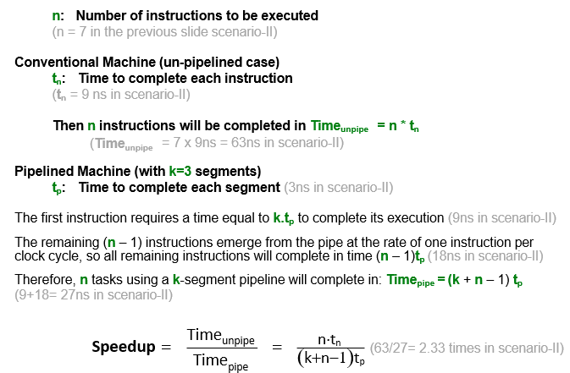
Speedup Scenario II

Slide 15
PIPELINE SPEEDUP
The generalized Speedup equation:
CPU time for the task unpipelined CPU time for the task pipelined
=
n⋅t_{n}
(k +n−1)t_{p}
is used to determine the speedup for any task which can be
implemented through pipelining.
In both scenarios I & II, un-pipelined execution of the task requires 21 clock cycles and pipelined execution requires 9 clock cycles.
– For the same task, speedup ratio of the pipelined and unpipelined executions of the task is independent of the “clock cycle time”. Therefore, speedup is the ratio of the number of clock cycles. “Clock cycle time” has no effect on the ratio.

Slide 16
WHAT IS THE MAXIMUM THEORETICAL SPEEDUP?
As n increases, speedup may simply be denoted as the ratio of t_{n}
to t_{p}:
– As the number of instructions increases, n becomes much larger than k - 1, and k + n - 1 approaches n; n/(k+n-1) approaches 1; and the speedup
approaches tn/tp.
Speedup =
t_{n} t_{p}
= k
(as t_{n}= k. t_{p})
– For instance, reconsider the 2 Scenarios on previous lecture slides with several very large values of n
Scenario-I (with large value of n) Scenario-II (with large value of n)
n=700, t_{n}=3, k=3, t_{p}=1
n=700, t_{n}=9, k=3, t_{p}=3
= ₍
n⋅t
n⋅t
=
n
)
n
k+n−1 t
( )
k+n−1 t
p
p
= ₍
700×9
=
700×3
(3+ 700−1)×1
)
3+ 700−1 ×3
≈ t_{n}
= ⁶³⁰⁰ =2.991
≈ t_{n}
= ⁹ = 3
3
= ²¹⁰⁰ =2.991
t_{p}
= ³ = 3
1
2106
t_{p}
702

Slide 17
WHAT IS THE MAXIMUM THEORETICAL SPEEDUP?
– For instance, reconsider the 2 Scenarios on previous lecture slides with several very large values of n
Scenario-I (with large value of n) n=700,000, t_{n}=3, k=3, t_{p}=1 ₌ ₍ n⋅t_{n )} k+n−1 t_{p} ₌ ₍ 700000×3 ₎ 3+ 700000−1 ×1 = ²¹⁰⁰⁰⁰⁰ =2.999991 ^{≈ tn = 3 = 3} 700002 ^{t}p 1 |  | Scenario-II (with large value of n) n=700,000, t_{n}=9, k=3, t_{p}=3 ₌ ₍ n⋅t_{n )} k+n−1 t_{p} ₌ ₍ 700000×9 ₎ 3+ 700000−1 ×3 = ⁶³⁰⁰⁰⁰⁰ =2.999991≈ ^{t}n = ⁹ = 3 2100006 t_{p 3}

Slide 18
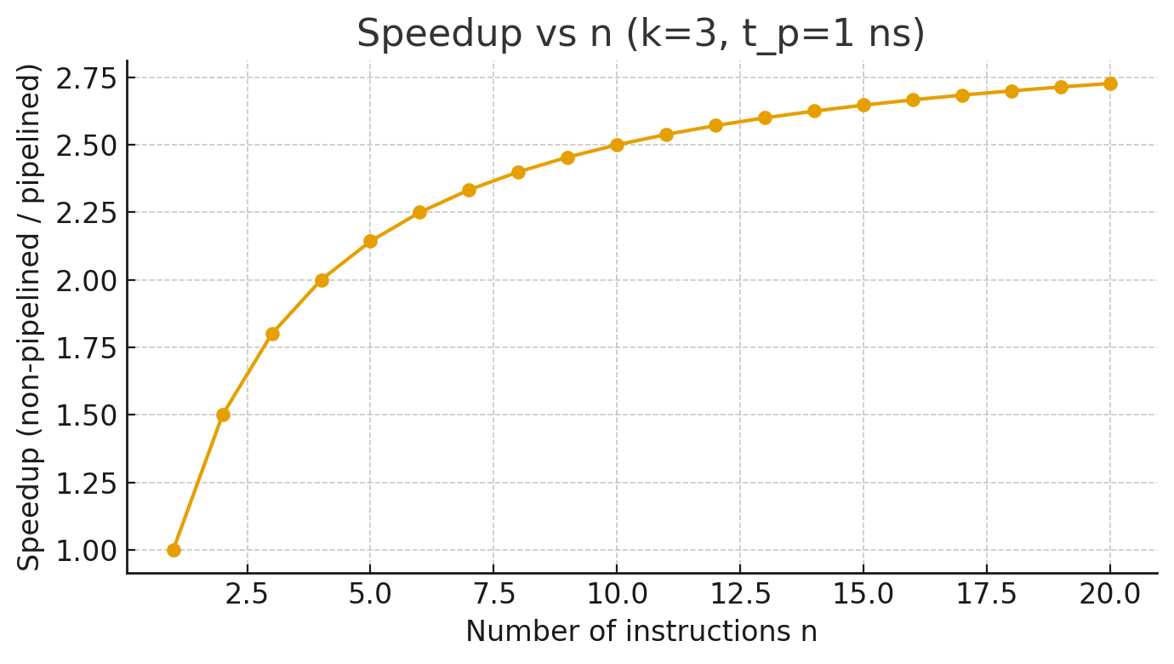

Slide 19
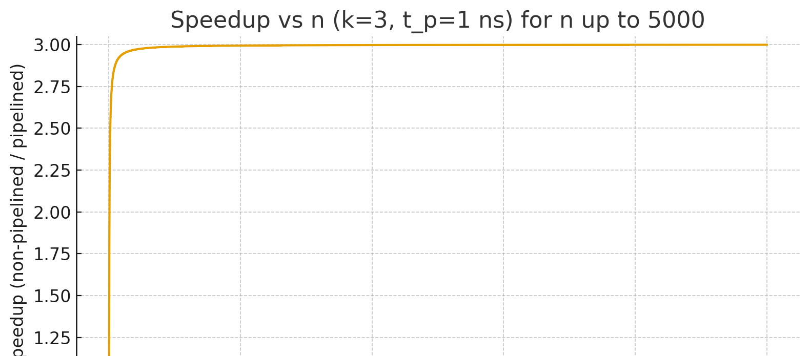

Slide 20
WHAT IS THE MAXIMUM THEORETICAL SPEEDUP?
This shows that the maximum speedup that a pipeline can “theoretically” achieve is k, which is the number of segments in that particular pipeline.
Maximum theoretical Speedup ≤ k
The maximum theoretical speedup is k since, in the best possible case, the processing time tn is partitioned exactly evenly among the k stages of the pipeline, and tp = tn/k.

